Slide 1


Slide 2

Starter task:
Talk to the people around you about your Christmas holidays?
The good, the bad, the ugly lets hear all about it….

Slide 3
Learning Intention:
Today we are learning about the scientific response to the teleological argument.
Success criteria:
By the end of the lesson I will be able to:
Explain the term “evolution” and “natural selection.”
Be clear on who Darwin was and what his theory involved.
Have considered if this theory is a realistic alternative to the intelligent design theory.

Slide 4
The mandatory content
Existence of God mandatory content.
Does God exist?
. What arguments/theories do religious people use to prove the existence of God?
. What evidence do religious people use to support these arguments/theories?
. What are the strengths and weaknesses of evidence/arguments/theories?
. What arguments/theories do non-religious people use to challenge the existence of God?
. What evidence do non-religious people use to support these arguments/theories?
. What are the strengths and weaknesses of evidence/arguments/theories?
. Can either religious or non-religious arguments/theories provide conclusive proof about the existence of God?

Slide 5

Recap task
On your desks write down everything you can remember about the Cosmological and teleological argument.
Try and include the names of the key thinkers involved and the responses to these theories.

Slide 6
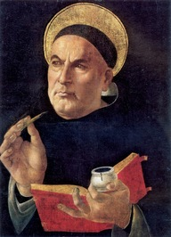
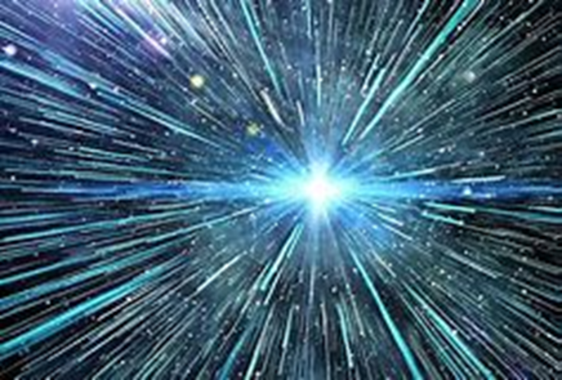
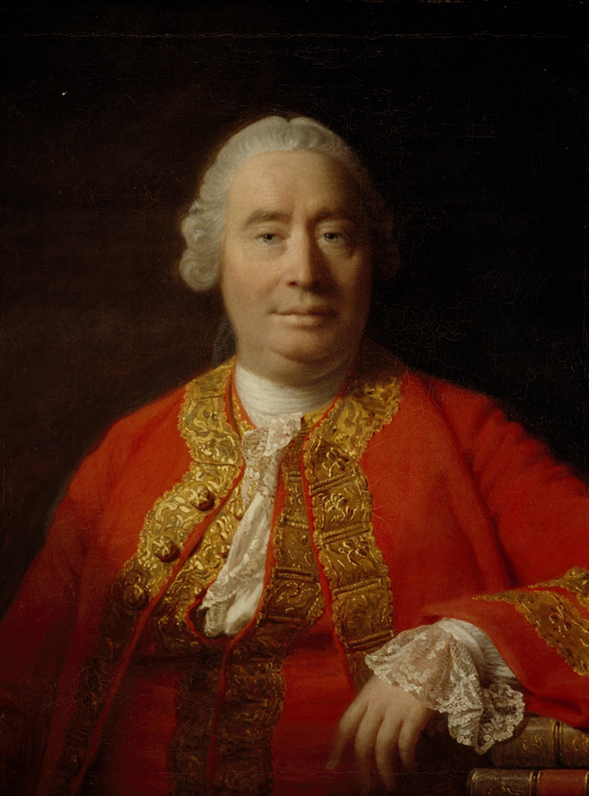
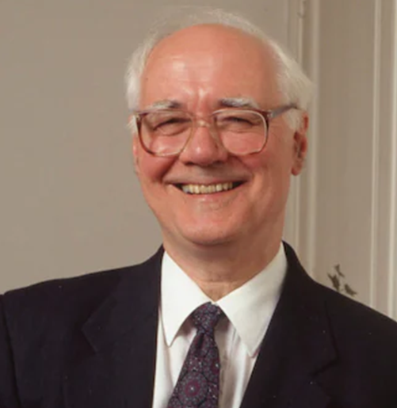

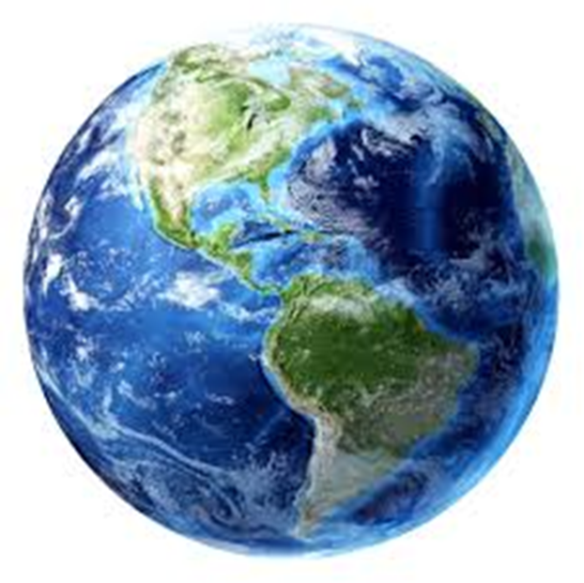


Slide 7
The scientific response to the Teleological argument.
Darwin's theory of evolution and natural selection is the idea that the universe and all life developed gradually over billions of years and that species have naturally changed to fit into this world. It is seen by some as evidence that there is no overall God as the cause or designer of the universe.
The word ‘evolution’ means ‘gradual development’
It is widely accepted as the best explanation for the origin and development of human life.
It is the scientific account of how life appeared on earth.
What is the religious theory of the origins of the earth?

Slide 8
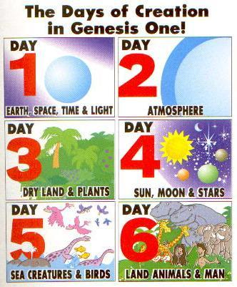
9.1.23 The Christian belief in the origins of the universe

Slide 9

Some Christians think that the story is an exact guide of how things happened – they take it literally.
Literal Christians: Christian Literalists believe that the creation story in Genesis 1 is absolutely true in every respect.
Remember
Christians believe that God has many characteristics; one being OMNIPOTENT (all powerful)
This means he can do anything.

Slide 10
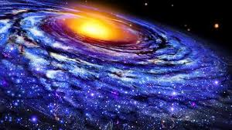
Other Christians don't believe that this is a divinely inspired story, just an early human attempt to make sense of the world around them.
Liberal Christians (symbolic): The Creation Story may point to truth through imagery, allegory and metaphor, even if it is not a historical account.
Remember
The purpose of the story is to convey a simple message that God created the universe.
Exactly how he did it is not important. What is important is that He did so.

Slide 11
The scientific response to the Teleological argument.

Slide 12
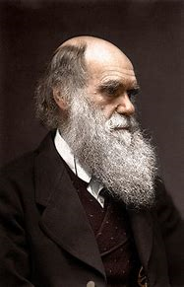
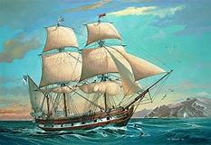
The theory of evolution by natural selection is linked back to Charles Darwin.
Charles Darwin (1809-1882)was an English scientist.
He originally wanted to be a doctor but realised the sight of blood made him queasy so he changed and began to study natural history.
On December 27, 1831, the HMS Beagle launched its voyage around the world with Darwin on board.

Slide 13
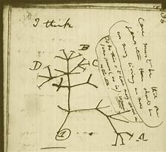
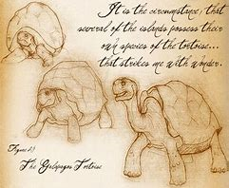
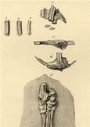
Over the course of the 5 year trip, Darwin collected a variety of natural specimens, including birds, plants and fossils.
Through hands-on research and experimentation, he had the unique opportunity to closely observe principles of botany, geology and zoology.

Slide 14
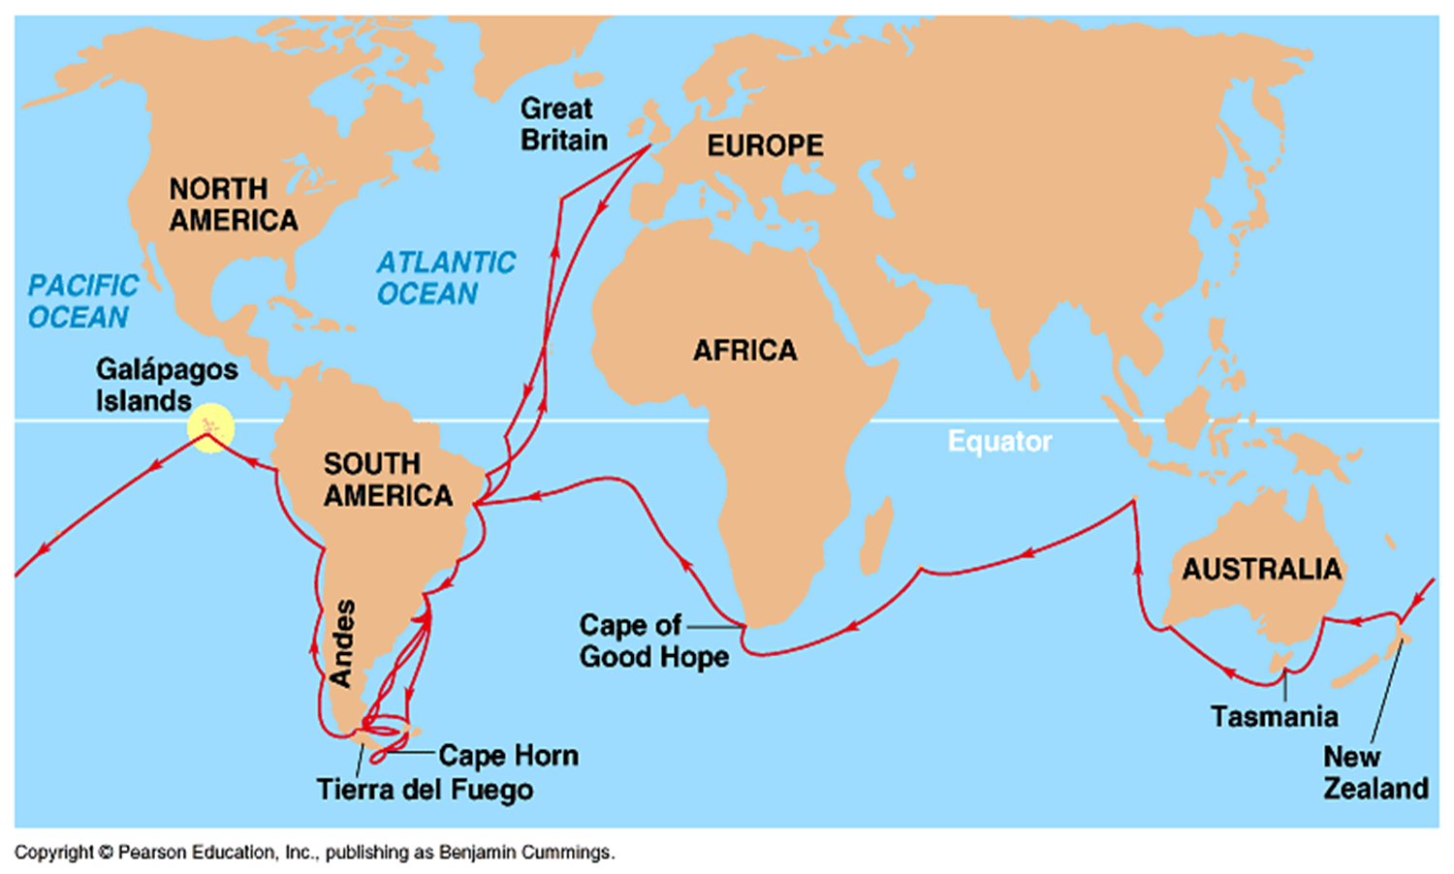
This is the route he took:

Slide 15
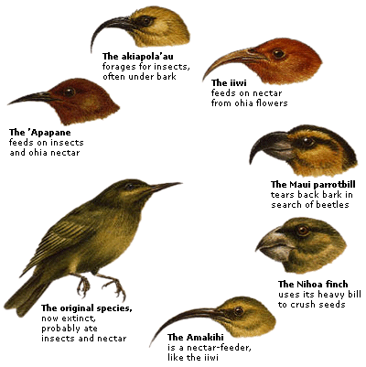
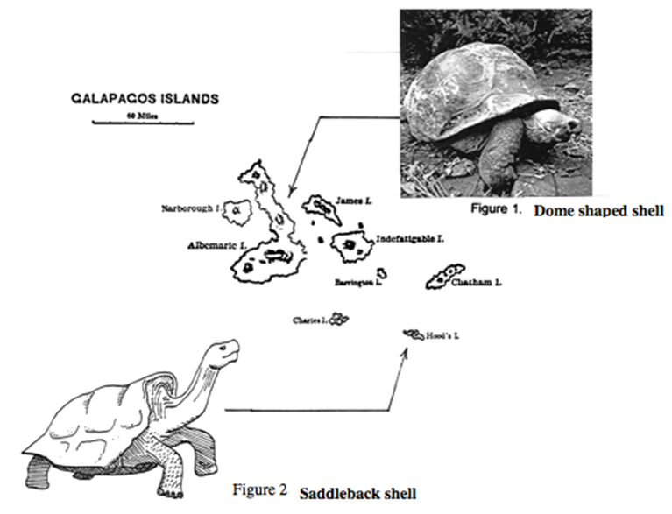
What did Darwin see?
On his travels he noticed:
1. Many species that were not found in Europe.
2: Lots of fossils.
He then stopped off at the Galapagos Islands where he found:
13 different types of finch
3 different types of tortoises

Slide 16

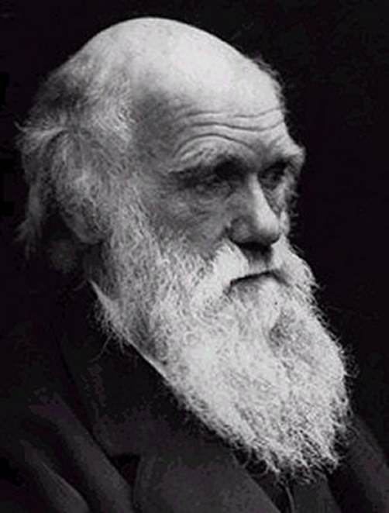
Question Time
Why would God create so many different species to suit each island?

Slide 17
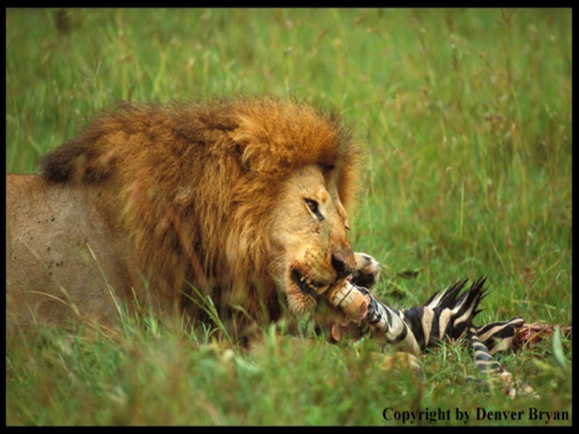
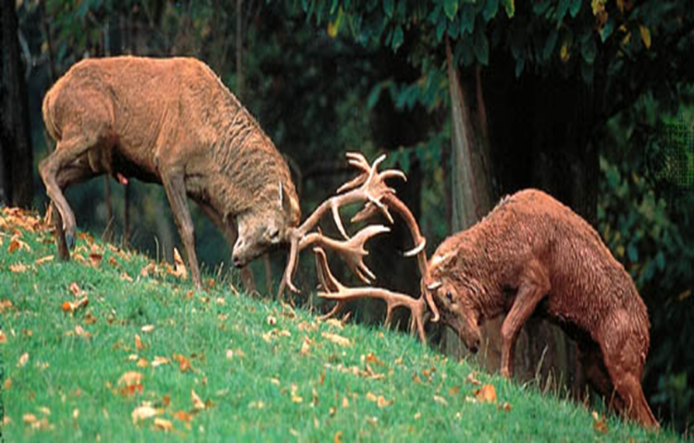
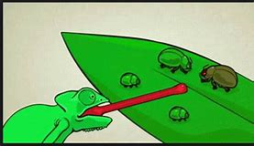
What happened next?
On return home, Darwin began working on his new theory and was influenced by several writers.
He liked the idea in T. Malthus of every being ‘fighting for survival’ where only the strongest survive. This is also known as Survival of the Fittest.
This led to the idea we now know of as natural selection.

Slide 18
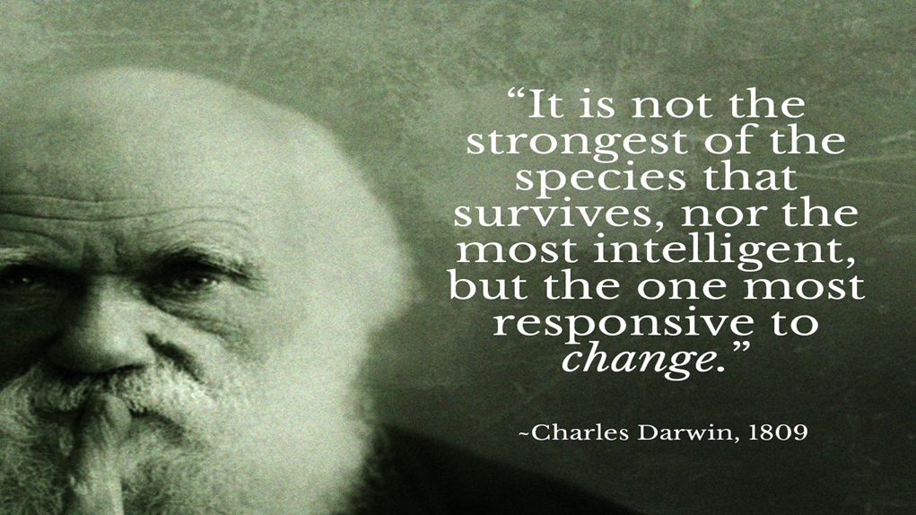
Natural selection is where only those species that successfully adapted, or evolved, to meet the changing requirements of their natural habitat survived (KU.)
.
This could be seen as a direct challenge to the idea of creation by a designer because …….(AN)
An excellent quote.

Slide 19
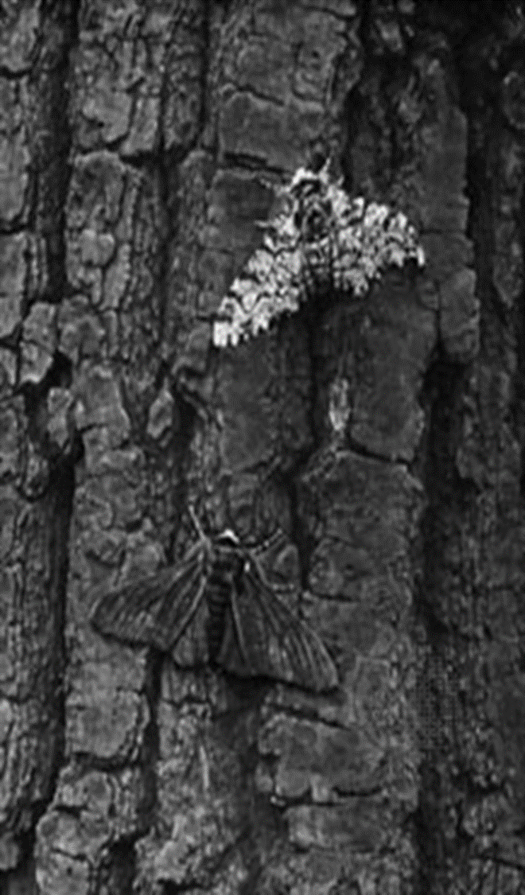
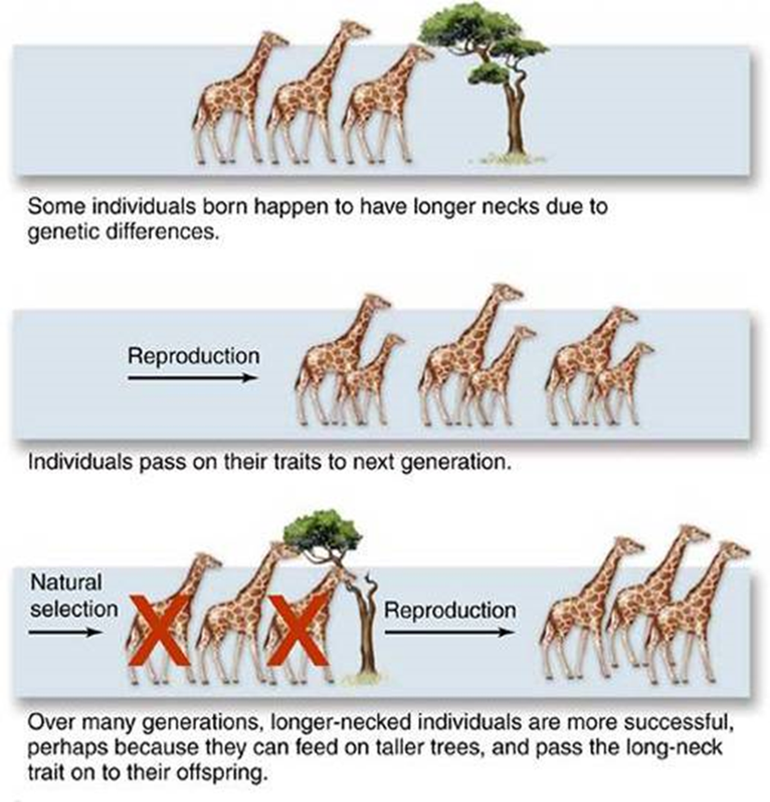
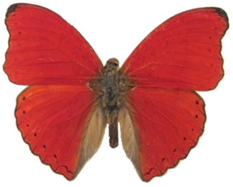

Slide 20
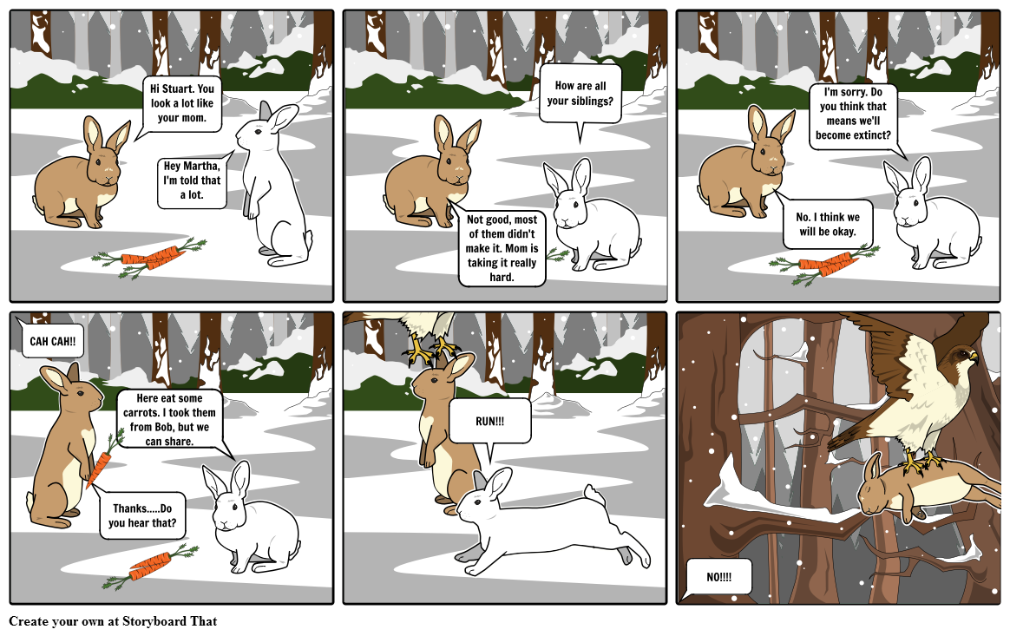

Slide 21
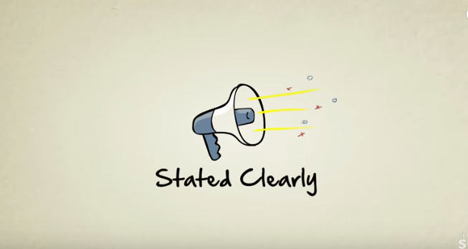
Lets watch this clip to add to our knowledge and understanding
Natural Selection
https://www.youtube.com/watch?v=0SCjhI86grU
What did we learn from this clip?

Slide 22
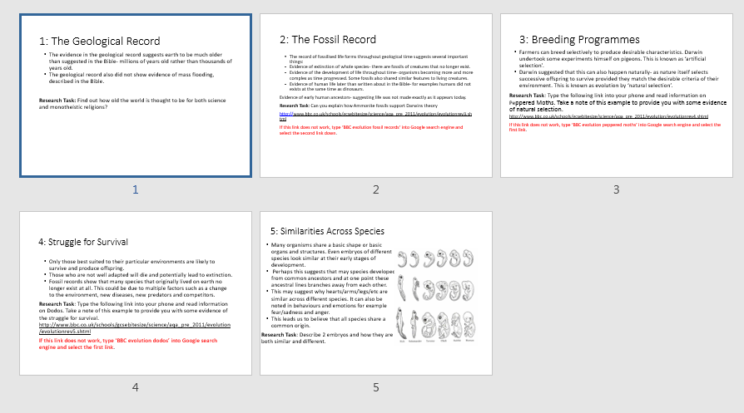
Homework. Explore the evidence to support Darwin's theory. Do the required task for each aspect and write this in your skills jotters. To be completed by Thursday Jan. 12th

Slide 23
Natural selection

Slide 24
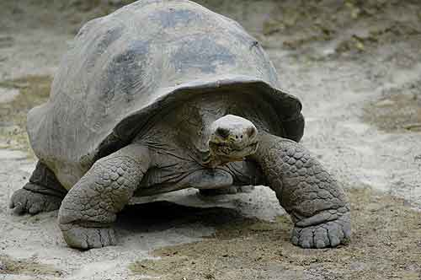
Case study
The Galapagos Islands were formed 3 million years ago by a volcanic eruption. Compared to the rest of the world which formed around 250-300 million years ago, they are quite new!
This means that all the species that live there must have flown, swum or drifted there since it’s formation.
The tortoises that can be found on the islands are suspected to have been blown there by the frequent storms that affect the islands.

Slide 25
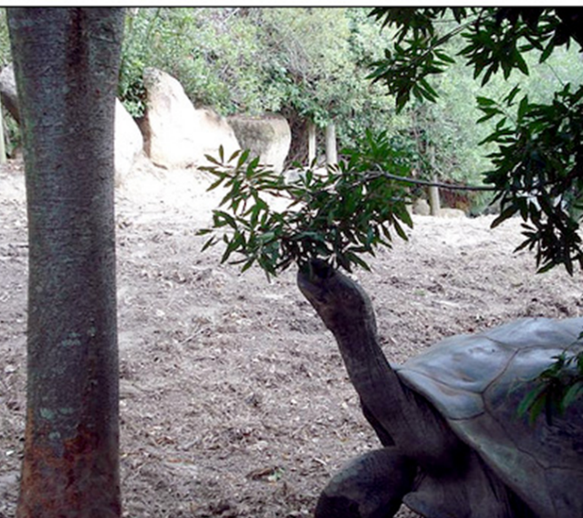
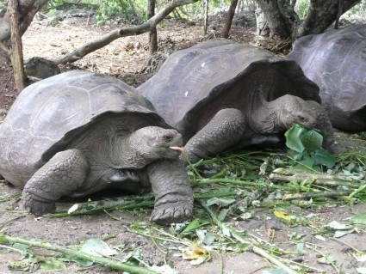
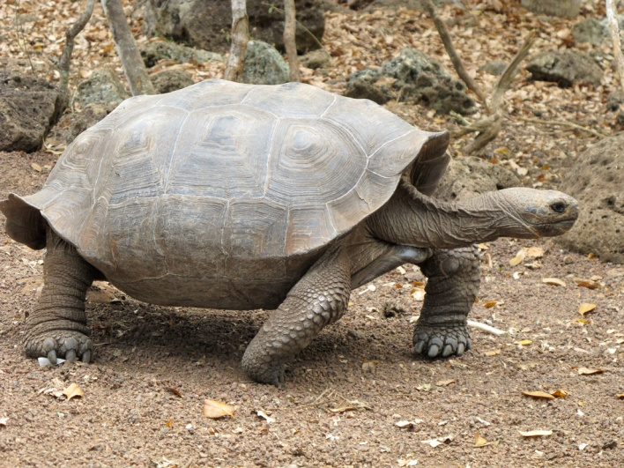
The Islands all have different types of food (plants) available to the tortoises:
ISLAND 1:
ISLAND 2:
ISLAND 3:
High up food meant that the baby tortoises with long necks were able to eat more, be stronger and reproduce.
Low plants meant that tortoises with short necks and flatter faces became the strongest.
A mixture of both types means that the tortoises with medium necks but higher shells can eat the most.
The shorter neck tortoises soon die out until you are left with only long neck tortoises.
The longer neck tortoises soon die out until you are left with only short neck tortoises.
The tortoises with long necks and low shells die out until you are left with intermediate tortoises.

Slide 26
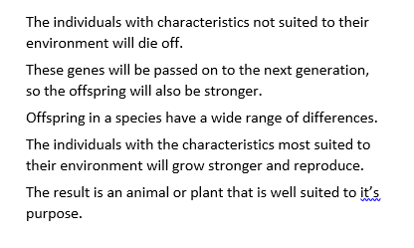

Task: Darwin's five points that explain natural selection.
Cut out each point and arrange them in the correct order.
Think about it carefully, it follows a logical progression.

Slide 27
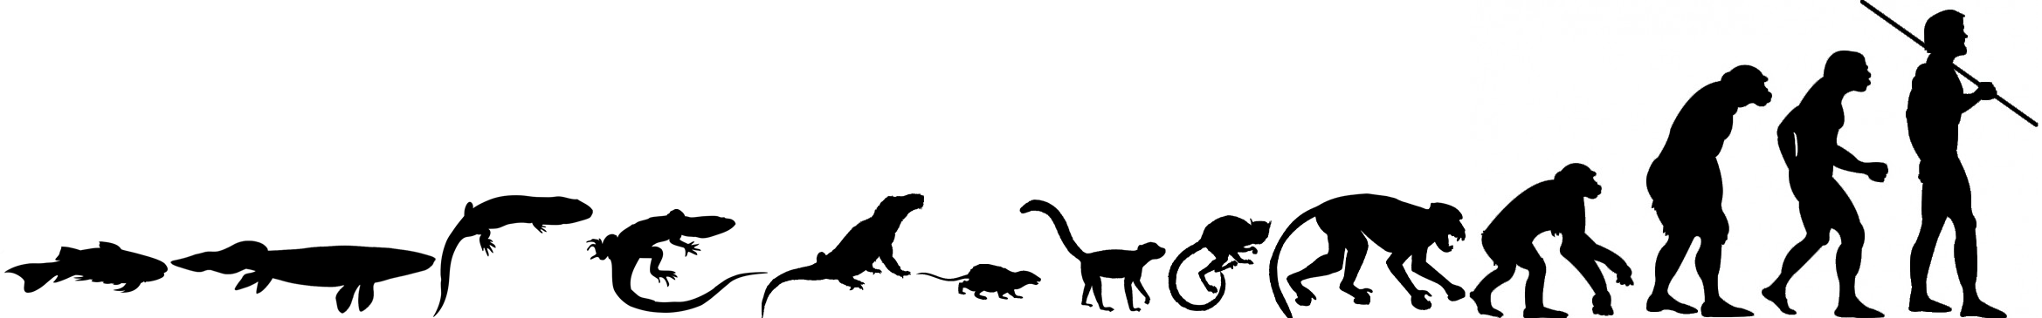

Natural selection is the engine that drives the idea of evolution.
Evolution takes the idea of natural selection and applies it to all living things including humans.
In Descent of Man Darwin applied his controversial theory to humans. He claimed that every life form on earth has stemmed from fish.
The FISH created muscular fins and crawled onto land.
Once on the land, AMPHIBIANS appeared.
REPTILES evolved from amphibians and later became
MAMMALS until eventually
MAN appeared.
See Timeline: http://www.bbc.co.uk/schools/gcsebitesize/science/aqa_pre_2011/evolution/evolutionrev2.shtml

Slide 28

Link our Learning
When Darwin’s book was published in 1859, it caused public outcry from the church.
Q: Why do you think it did this?
A: In Darwin’s time, Christians refused to accept his theory. They believed it to be an attack on the creation story in Genesis

Slide 29
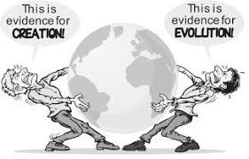
Suggesting humans have evolved form fish and developed through natural selection is very different from believing in Paley’s teleological theory that humans are created by an intelligent designer with a specific purpose.
At the time some Christians responded with outrage and fury.
How dare this man suggest The Bible is inaccurate.
How dare he challenge the very nature of God.
How dare he suggest life is not as we know it.
This issue continues to divide Christin thinking.
TASK: Think about the distinction between literal and liberal Christians. How could they responds to Darwins claims?

